Slide 1

Dr. Sajid Iqbal
Department of Computer Science
Bahauddin Zakariya University, Multan

Slide 2

INTRODUCTION TO Machine Learning 3rd Edition
ETHEM ALPAYDIN
© The MIT Press, 2014
alpaydin@boun.edu.tr
http://www.cmpe.boun.edu.tr/~ethem/i2ml3e

Slide 3
4.5 Parametric Classification

Slide 4



Binary Parametric Classification - Example
Let we consider the dataset given in carsales.csv file
Apply Bayesian Theorem
Here $θ$ is the class to be predicted
Whether customer purchases a car or not
From dataset we get
Prior $P\left(θ\right)$: what is the probability that a customer purchases a car
Likelihood $p\left(X | θ\right)$:
$$p\left(θ | X\right)=\frac{p\left(X | θ\right)P\left(θ\right)}{P\left(X\right)}$$

Slide 5


Total Instances in our DS (Population size) = 400
X: salary more than 50000 is our sample
The probability of purchasing a car
$P\left(θ=1\right)=143$
Probability that a person who has purchased a car has salary more than 50000
$P\left(X>50000|θ=1\right)=99$
Probability of persons with salary more than 50000
$P\left(X>50000\right)=276$
The probability that a person with salary higher than 50000 will purchase a car
$P\left(θ=1|X>50000\right)=P\left(X>50000|θ=1\right)P\left(θ=1\right)/P\left(X>50000\right)$
$=99∗\frac{143}{276}=51.294$
$$p\left(θ | X\right)=\frac{p\left(X | θ\right)P\left(θ\right)}{P\left(X\right)}$$

Slide 6
Exercise
Solve above example for persons having following salaries
10000
>80000
<100000
50000-100000

Slide 7

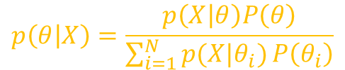




Multi-Classification Using Naïve Bayes
Dataset Description
Four columns: sepal width, sepal length, petal width, petal length, class
$θ=\left[′Iris−setosa′, ′Iris−versicolor′, ′Iris−virginica’\right]=3$
Priors
Likelihoods
$$P\left(x=6|θ_{1}\right)=0/3$$
$$P\left(x=6|θ_{2}\right)=2/4$$
$$P\left(x=6|θ_{3}\right)=4/5$$
$$P\left(x=7|θ_{1}\right)=0/3$$
$$P\left(x=7|θ_{2}\right)=1/4$$
$$P\left(x=7|θ_{3}\right)=0/5$$
$$P\left(θ_{1}=^{′}Iris−setosa′\right)=3/12$$
$$P\left(θ_{2}=^{′}Iris−versicolor′\right)=4/12$$
$$P\left(θ_{3}=^{′}Iris−virginica′\right)=5/12$$
$$P\left(x=4|θ_{1}\right)=2/3$$
$$P\left(x=4|θ_{2}\right)=0/4$$
$$P\left(x=4|θ_{3}\right)=0/5$$
$$P\left(x=5|θ_{1}\right)=1/3$$
$$P\left(x=5|θ_{2}\right)=1/4$$
$$P\left(x=5|θ_{3}\right)=1/5$$

Slide 8






Multi-Classification Using Naïve Bayes
Priors
Likelihoods
$P\left(x=4 | θ_{1}\right)=2/3$
$P\left(x=5 | θ_{1}\right)=1/3$
$P\left(x=6|θ_{1}\right)=0/3$
$P\left(x=7|θ_{1}\right)=0/3$
(after rearranging)
$$P\left(θ_{1}\right)=3/12$$
$$P\left(θ_{2}\right)=4/12$$
$$P\left(θ_{3}\right)=5/12$$
$P\left(x=4 | θ_{2}\right)=0/4$
$P\left(x=5 | θ_{2}\right)=1/4$
$P\left(x=6|θ_{2}\right)=2/4$
$P\left(x=7|θ_{2}\right)=1/$4
$P\left(x=4 | θ_{3}\right)=0/$5
$P\left(x=5 | θ_{3}\right)=1/5$
$P\left(x=6|θ_{3}\right)=4/5$
$P\left(x=7|θ_{3}\right)=0/5$
$$\sum_{i=1}^{3}{\left[\left(\frac{2}{3}+\frac{1}{3}+\frac{0}{3}+\frac{0}{3}\right)∗\frac{3}{12}\right)+\left(\frac{0}{4}+\frac{1}{4}+\frac{2}{4}+\frac{1}{4}\right)∗\frac{4}{12}+\left(\frac{0}{5}+\frac{1}{5}+\frac{4}{5}+\frac{0}{5}\right)∗\frac{5}{12}]}$$
$$\sum_{i=1}^{3}{\left[\left(\frac{2}{3}+\frac{1}{3}\right)∗\frac{3}{12}\right)+\left(\frac{1}{4}+\frac{2}{4}+\frac{1}{4}\right)∗\frac{4}{12}+\left(\frac{1}{5}+\frac{4}{5}\right)∗\frac{5}{12}]}$$
$$\sum_{i=1}^{3}{\left[\left(\frac{3}{3}\right)∗\frac{3}{12}\right)+\left(\frac{4}{4}\right)∗\frac{4}{12}+\left(\frac{5}{5}\right)∗\frac{5}{12}]}→\frac{3}{12}+\frac{4}{12}+\frac{5}{12}→1$$
Hence, denominator in Bayes theorem can be ignored

Slide 9






Prediction using Bayes Theorem
$$p\left(θ | X\right)=p\left(X | θ\right)P\left(θ\right)$$
$$P\left(θ_{1}\right)=3/12$$
$$P\left(θ_{2}\right)=4/12$$
$$P\left(θ_{3}\right)=5/12$$
What is the probability that a flower for sepal length 6 belongs to
Class 1, class 2, class 3
$p\left(θ_{i} | X\right)=p\left(X | θ_{i}\right)P\left(θ_{i}\right)$
For class-i
$p\left(θ_{1} | X=6\right)=\frac{0}{3}∗\frac{3}{12}=0$
$p\left(θ_{2} | X=6\right)=\frac{2}{4}∗\frac{4}{12}=\frac{1}{6}$
$p\left(θ_{3} | X=6\right)=\frac{4}{5}∗\frac{5}{12}=\frac{1}{3}$
Its MAP estimate is given by
$Argmax \left(0 ,\frac{1}{6},\frac{1}{3}\right)→\frac{1}{6}$ Hence value 6 belongs to class 3.
$$P\left(x=4 | θ_{1}\right)=2/3$$
$$P\left(x=5 | θ_{1}\right)=1/3$$
$$P\left(x=6|θ_{1}\right)=0/3$$
$$P\left(x=7|θ_{1}\right)=0/3$$
$$P\left(x=4 | θ_{2}\right)=0/4$$
$$P\left(x=5 | θ_{2}\right)=1/4$$
$$P\left(x=6|θ_{2}\right)=2/4$$
$P\left(x=7|θ_{2}\right)=1/$4
$P\left(x=4 | θ_{3}\right)=0/$5
$$P\left(x=5 | θ_{3}\right)=1/5$$
$$P\left(x=6|θ_{3}\right)=4/5$$
$$P\left(x=7|θ_{3}\right)=0/5$$

Slide 10
Exercise: Multi-classification
Extend this working for multi-featured dataset
Take the breast cancer detection dataset from
https://www.kaggle.com/uciml/breast-cancer-wisconsin-data
Apply the studied theory on it.
A good example is given here, try to understand and apply it on your problem
https://machinelearningmastery.com/naive-bayes-classifier-scratch-python/

Slide 11
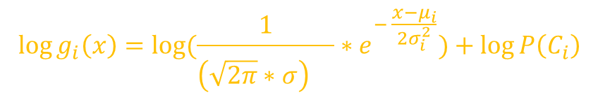

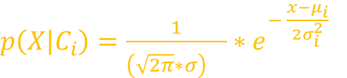
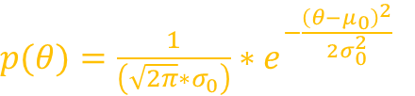

Parametric Classification
The discriminant function is
$g_{i}\left(x\right)=p\left(X | θ_{i}\right)P\left(θ_{i}\right)$
$g_{i}\left(x\right)=p\left(X | C_{i}\right)P\left(C_{i}\right)$ if we are working with multiple classes
$\log{g_{i}\left(x\right)}=\log{p\left(X | C_{i}\right)}+\log{P\left(C_{i}\right)}$
Let assume the underlying distribution is gaussian
Putting this value in above equation
$$p\left(θ | X\right)=\frac{p\left(X | θ\right)P\left(θ\right)}{P\left(X\right)}$$
$$p\left(θ | X\right)=\frac{p\left(X | θ\right)P\left(θ\right)}{\sum_{i=1}^{N}{p(X|θ_{i})}P\left(θ_{i}\right)}$$
$p\left(X | C_{i}\right)=\frac{1}{{\left(\sqrt{2π}∗σ\right)}^{} }∗e^{− \frac{x−μ_{i}}{2σ_{i}^{2}}}$
$p(θ)=\frac{1}{\left(\sqrt{2π}∗σ_{0}\right)}∗e^{−\frac{{\left(θ−μ_{0}\right)}^{2}}{2σ_{0}^{2}}}$
$$\log{g_{i}\left(x\right)}=\log{(\frac{1}{{\left(\sqrt{2π}∗σ\right)}^{} }∗e^{− \frac{x−μ_{i}}{2σ_{i}^{2}}})}+\log{P\left(C_{i}\right)}$$

Slide 12

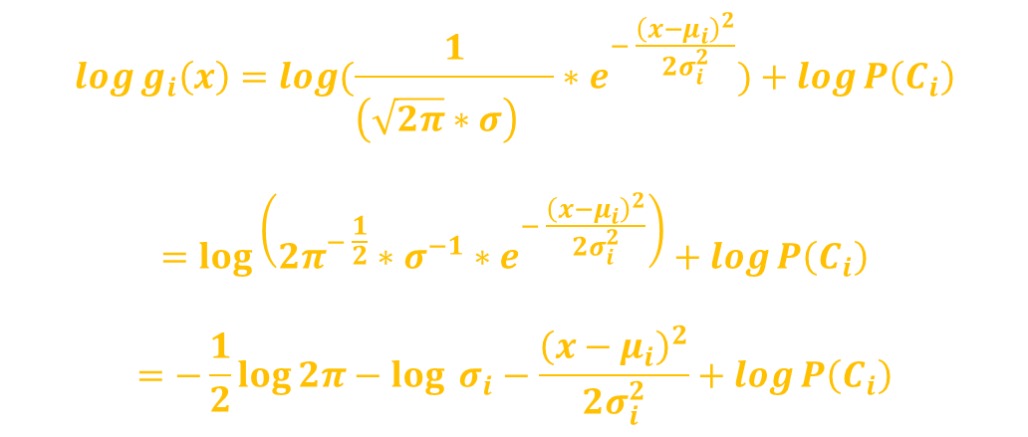
$$\log{g_{i}\left(x\right)}=\log{(\frac{1}{{\left(\sqrt{2π}∗σ\right)}^{} }∗e^{− \frac{{\left(x−μ_{i}\right)}^{2}}{2σ_{i}^{2}}})}+\log{P\left(C_{i}\right)}$$
$$=\log\left(2π^{− \frac{1}{2}}∗σ^{−1}∗e^{− \frac{{\left(x−μ_{i}\right)}^{2}}{2σ_{i}^{2}}}\right)+\log{P\left(C_{i}\right)}$$
$$=−\frac{1}{2}\log{2π}−\log{{ σ}_{i}}−\frac{{\left(x−μ_{i}\right)}^{2}}{2σ_{i}^{2}}+\log{P\left(C_{i}\right)}$$
$$∴ \log{e^{x}=x}$$

Slide 13

Example
Let A is car company that sells k-type of cars
Let customer choice is based on its yearly income x
$P(C_{i})$ is the portion of customers who buy car $C_{i}$
Let the yearly income distribution is supposed to be normal
$p\left(x | C_{i}\right)\sim N(μ_{i},σ_{i}^{2}):$Probability that a customer who bought car type $i$ has income $x$
$μ_{i}=$ mean income of customers buying car type $C_{i}$
$σ_{i}^{2}=$ variance of income of such customers
If $P(C_{i})$ and $p(x|C_{i})$is not known, it can be estimated from sample

Slide 14
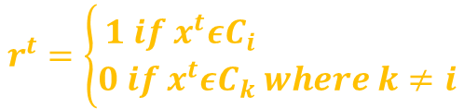


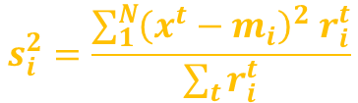

Example
Let we have sample $X={\left\{x^{t}, r^{t}\right\}}_{t=1}^{N}$where
For normal distribution, the parameters are $μ$ and $σ$
The parameter estimates are given as
Estimate for prior
$$r^{t}=\left\{\begin{aligned}1 if x^{t}εC_{i} \\ 0 if x^{t}εC_{k} where k≠i\end{aligned}\right.$$
$$m_{i}=\frac{\sum_{1}^{N}{x^{t}r_{i}^{t}}}{\sum_{t}{r_{i}^{t}}}$$
$$s_{i}^{2}=\frac{\sum_{1}^{N}{{\left(x^{t}−m_{i}\right)}^{2} r_{i}^{t}}}{\sum_{t}{r_{i}^{t}}}$$
$$P\left(C_{i}\right)=\frac{\sum_{t}{r_{i}^{t}}}{N}$$

Slide 15



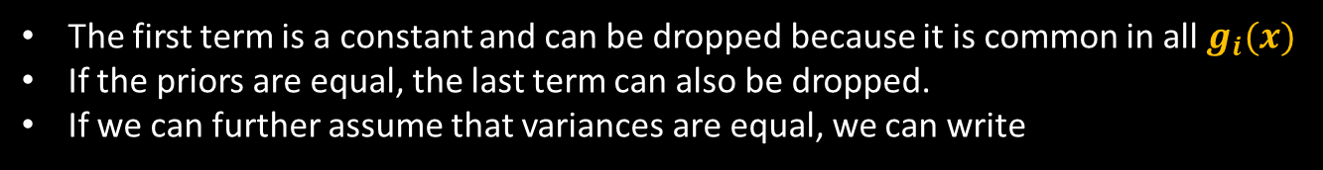
Example
$$\log{g_{i}\left(x\right)}=−\frac{1}{2}\log{2π}−\log{{ s}_{i}}−\frac{{\left(x−m_{i}\right)}^{2}}{2s_{i}^{2}}+\log{P\left(C_{i}\right)}$$
The first term is a constant and can be dropped because it is common in all $g_{i}(x)$
If the priors are equal, the last term can also be dropped.
If we can further assume that variances are equal, we can write
$$P\left(C_{i}\right)=\frac{\sum_{t}{r_{i}^{t}}}{N}$$
$$g_{i}(x) = −{\left(x − m_{i}\right)}^{2}$$
Assign x to the class with the nearest mean
$$Choose C_{i} if \left|x−m_{i}\right|=\min_{k}\left|x−m_{k}\right|$$

Slide 16




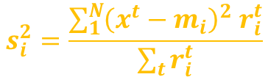
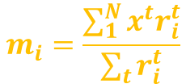
Exercise
Using python and numpy
Create a collection of 100 values which are normally distributed with mean 50000 and standard deviation 10000
There are 3 cars in your dataset Suzuki Mehran, Faw V2, Toyota Vitz
Randomly assign a car to a salaried person. The shape of dataset is as follows:
Now using this 100 itemset, we estimate the population distribution
Find the parameters of normal density using formulas
Here X=[salary, grade]
Estimate $P(X|m,s^{2})$ using formula
$$m_{i}=\frac{\sum_{1}^{N}{x^{t}r_{i}^{t}}}{\sum_{t}{r_{i}^{t}}}$$
$p\left(X | C_{i}\right)=\frac{1}{{\left(\sqrt{2π}∗σ\right)}^{} }∗e^{− \frac{x−μ_{i}}{2σ_{i}^{2}}}$
$$s_{i}^{2}=\frac{\sum_{1}^{N}{{\left(x^{t}−m_{i}\right)}^{2} r_{i}^{t}}}{\sum_{t}{r_{i}^{t}}}$$
$$Choose C_{i} if \left|x−m_{i}\right|=\min_{k}\left|x−m_{k}\right|$$

Slide 17
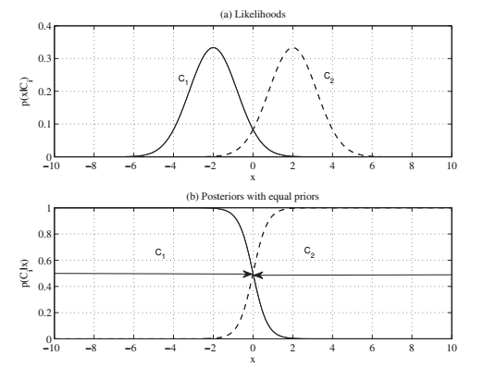

Example
For two classes, the mid point bet. Two means is the threshold of decision
$g_{1}\left(x\right)=g_{2}(x)$
${\left(x−m_{1}\right)}^{2}={\left(x−m_{2}\right)}^{2}$
$\left(x−m_{1}\right)=\left(x−m_{2}\right)$
$2x=m_{1}+m_{2}$
$x=\frac{m_{1}+m_{2}}{2}$
(a) Likelihood functions
(b) posteriors with equal priors for two classes when the input is one-dimensional.
Variances are equal and the posteriors intersect at one point, which is the threshold of decision

Slide 18
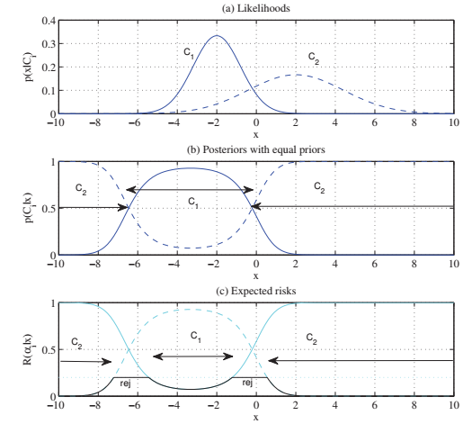
Example
When the variances are different, there are two thresholds which can be calculated easily
If the priors are different, this has the effect of moving the threshold of decision toward the mean of the less likely class

Slide 19



Thanks for watching
Dr. Sajid Iqbal
Assistant Professor
Department of Computer Science
Bahauddin Zakariya University, Multan
sajidiqbal.pk@gmail.com
https://github.com/sajjo79/Design_and_Analysis_of_Algorithms
Allah Hafiz
COMEDXD

Slide 20
Assignments

